Slide 1
Hong Kong

Slide 2
New Numbers
Numbers are usually only assigned in ranges of 100 and assigned from XXXXXX00 to XXXXXX99
We can assign single numbers where requested for certain area codes.
Numbers can be allocated in Consecutive Series, additional charges applicable if the number range has “Auspicious Category” & are chargeable (case by case).

Slide 3
Number Porting
Completed LOA (as per the next slide)
Emergency services address required
Latest bill containing numbers from supplier required
Out of hours porting not supported
Porting time Monday to Friday 9am – 5pm (Fridays not recommended)
Porting window 0 – 3 hours but can extended depending on losing carrier
Partial port not usually supported but if the losing carrier splits the number this may be supported
Roll Back is not supported but may be achievable via the customer approaching the losing carrier for an emergency restore. This depends on the losing carrier supporting this.
Additional information/documentation maybe requested at the time of port
Any change requests (date changes or cancellations) require at least 5WD notice

Slide 4
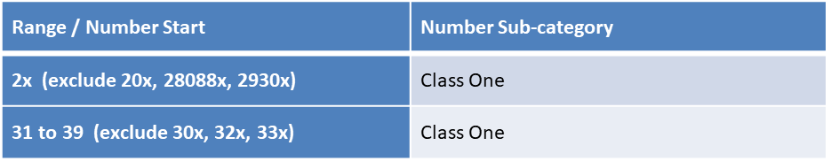
Number Porting
SBO class 1 numbers supported
Please refer to class 1 number range below:
Link refers to local plan and displays current range holder
https://www.ofca.gov.hk/filemanager/ofca/tc/content_311/no_plan.pdf
The business registration prefix does not start with 0, 5 or 6 & with total 8 numbers digit
maximum numbers to port is 1,000 numbers each timeslot, there are 4 time slots in one day i.e 4,000 numbers max in one day

Slide 5
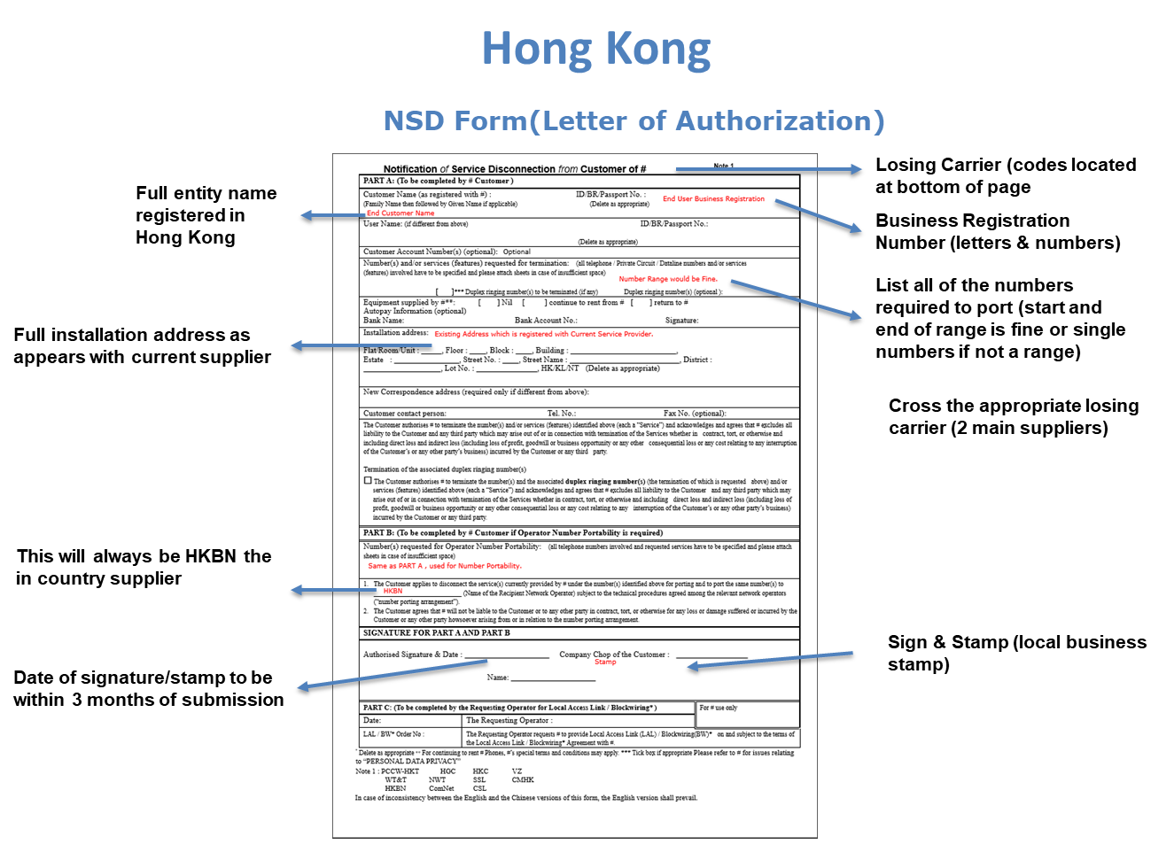

Slide 6
Singapore

Slide 7
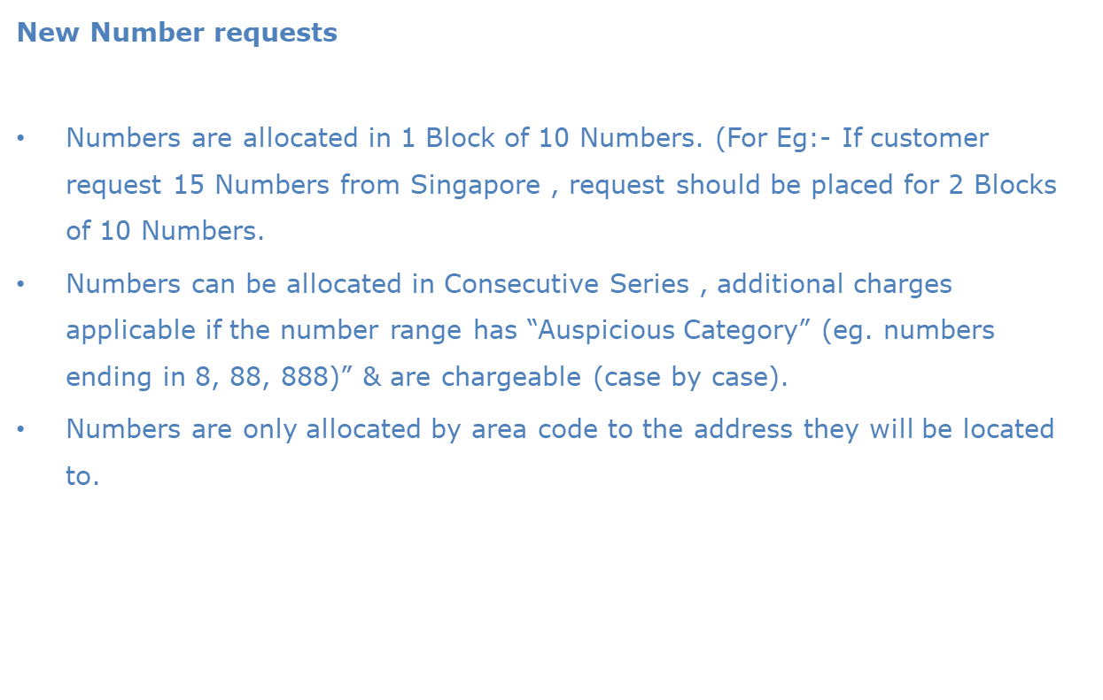

Slide 8
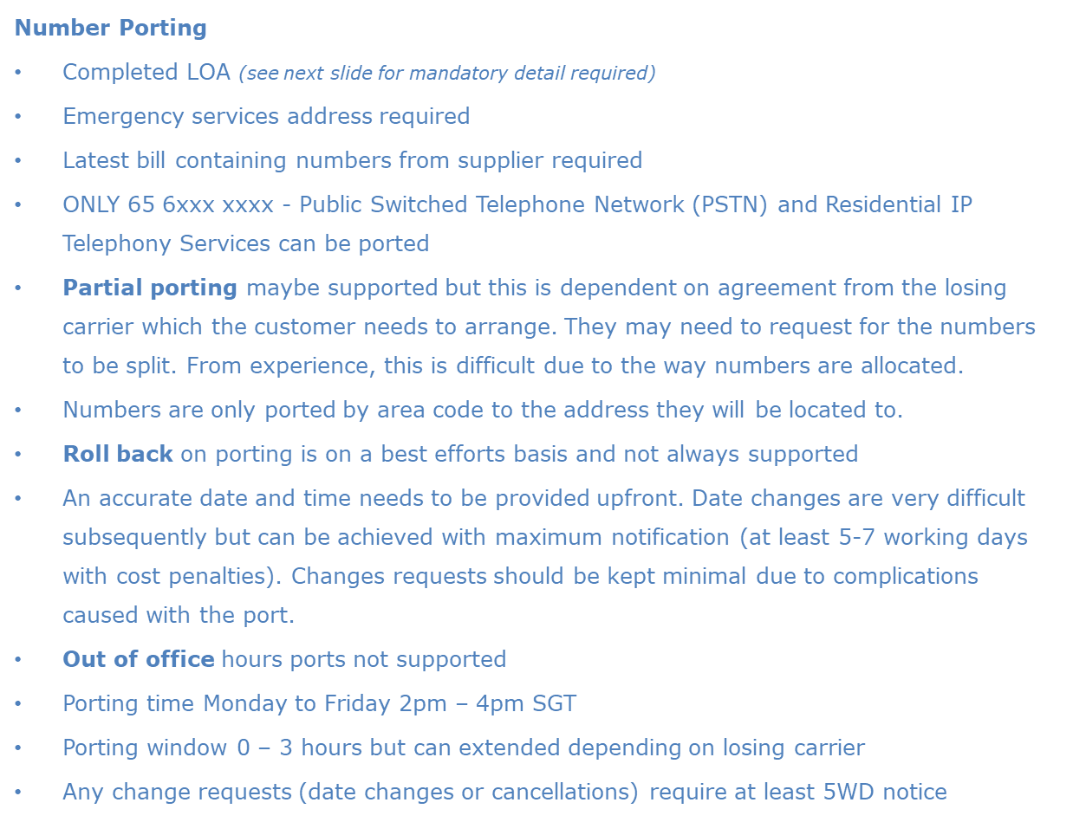

Slide 9
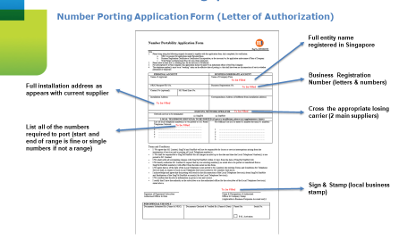

Slide 10

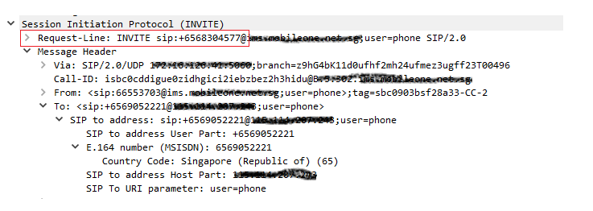
Number Porting
Due to the porting process in Singapore, numbers required to be ported are pointed by the losing carrier to a ‘medium’ number.
Call processing on SBC/PABX should happen on “Request-Line” number. (as highlighted in screen shot below)
The number in “To” is the ‘N2’ number – which is necessary between TATA & supplier to complete the porting exercise.

