Slide 1

Optimising Accessibility
Making Word Documents Accessible

Slide 2

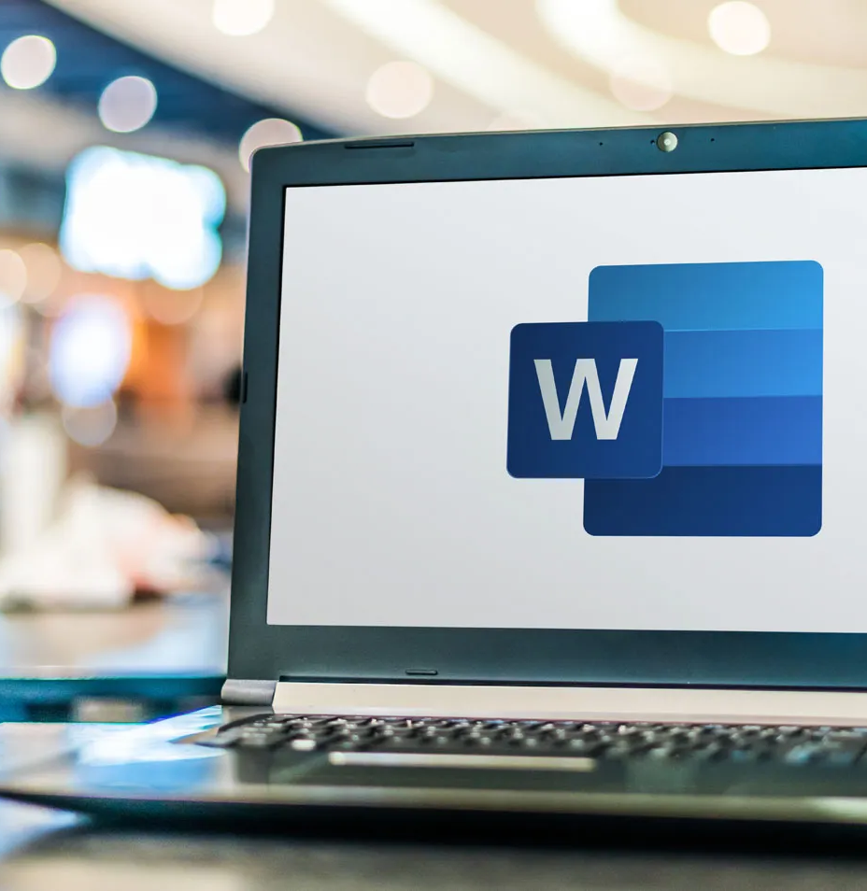


Accessibility in Microsoft Word
Microsoft Word is a word processor that can be found as part of Office 365, as one of a suite of applications from Microsoft.

Slide 3
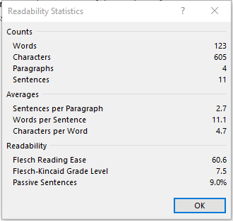
Use clear and easy to understand language
Consider your target audience and use easy-to-understand sentences as much as possible.
Use Word’s spelling, grammar and readability checkers to fix any grammar or spelling mistakes. In some versions of Word, you can enable readability by:
  Open your Word document.
  Select the Home tab.
  Choose Editor, and then go to Document Stats.
A dialog box lets you know Word is calculating your document stats. Choose OK.
Word will open a window that shows you information about the statistics and reading level of your document

Slide 4
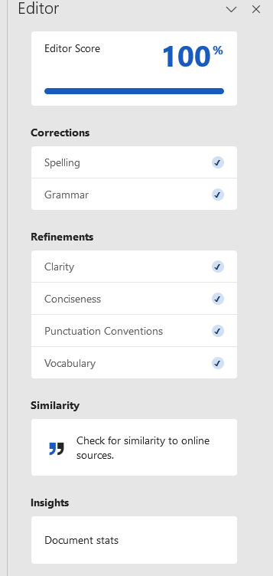
Use “editor” if available
If your version of Word supports Editor, it provides a user-friendly interface for correcting spelling, grammar and readability.
Open “Editor” in the Home tab to view and correct issues.
Click on “Settings” to customise the suggestions.
Notes:
PowerPoint has a checker to help you with this. It is a quick and simple way of making sure that there are no major accessibility challenges in your deck. Using it is simple and can be found on the review tab

Slide 5
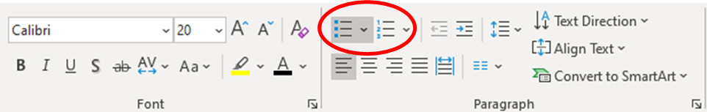
Structure text with styles, headings, and lists
Use ‘Headings to structure the document, and ‘Normal’ style for paragraphs. This makes it easier to navigate with a screen reader. Ensure Headings nest, starting with one H1.
Using real headings (instead of only making titles visually bigger and bold) helps create tables of contents, which update as the document is modified.
The table of contents allows readers to jump to different headings.
You can find, modify and apply styles in the “Styles” pane
Make use of built-in ‘numbered’ or ‘bulleted’ lists as they are recognised as lists and work with a screen reader.

Slide 6
Consider font size, type, and weight
Accessibility 8
Readable font-size
Font sizes should be at least 12 pt.
Accessible font-type
The Colt brand font for documentation is Arial which is good for readability and legibility and is also universally supported across platforms and devices.
Accessible font-weight
Some fonts have thin, lite, narrow or heavy varieties that can be difficult to read. Avoid the use of Arial Narrow or Arial Black in your documents.
Accessibility 12
Accessibility 14
Accessibility 18
Accessibility 24
Accessibility 36
Accessibility 48

Slide 7
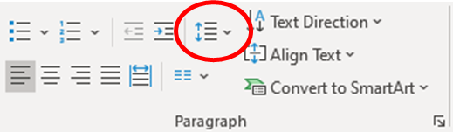
Use appropriate line and paragraph spacing
Spacing improves the legibility of a document and breaks the material into sections. Line spacing of “1.15” and paragraph spacing of “6pt” before is ideal and can be applied by:
selecting the style in the style page;
selecting “Modify style”;
choose “Format”;
choose “Paragraph”;
set before to “6pt” and line-spacing to “1.15”.
Use appropriate paragraph spacing whenever you have to create large empty separations between elements in a page, instead of pressing ‘enter’ many times.

Slide 8
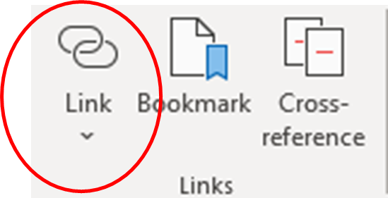
Use in-built accessibility checker
Avoid using the entire web address as hyperlink text in the document, as it will be spoken out loud by a screen reader and difficult to understand by the user.
Use the text or word that best describes their purpose or content for hyperlinks. For example, if you are including a link to a webpage, your link should be the page’s name.
Avoid hyperlinks such as “click here”. Always describe the content of the link. This makes browsing links easier.
Where possible, check external links for accessibility before recommending them.

Slide 9
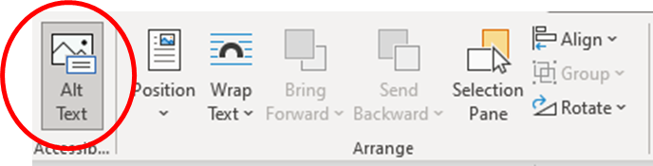
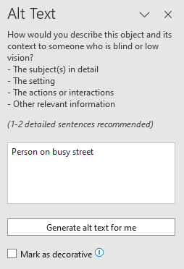
Images, charts, and graphics
Add image descriptions to essential images and charts.
  Right-click on the Image or chart and select “Edit Alt text” or open the Alt Text menu
  Enter an image description (short but meaningful).
  Image descriptions will be read aloud by a screen reader, helping users who have difficulty seeing the content.
Mark non-essential visual elements as decorative. This means that a screen reader will ignore this image or element, making the document more navigable.

Slide 10
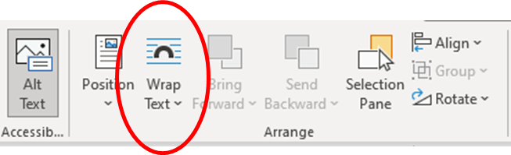
Choose in line wrapping for essential images
Select the image.
Right click and choose “Wrap Text”.
Select ‘In line with text’ in the toolbar.
This puts the image in logical reading order within the text, so a screen reader will read it when you intend it to be read.
In some cases, you may not be able to make a graphic element in line; in this case ensure it is marked as decorative so as not to confuse a screen reader.
Notes:
PowerPoint has a checker to help you with this. It is a quick and simple way of making sure that there are no major accessibility challenges in your deck. Using it is simple and can be found on the review tab

Slide 11
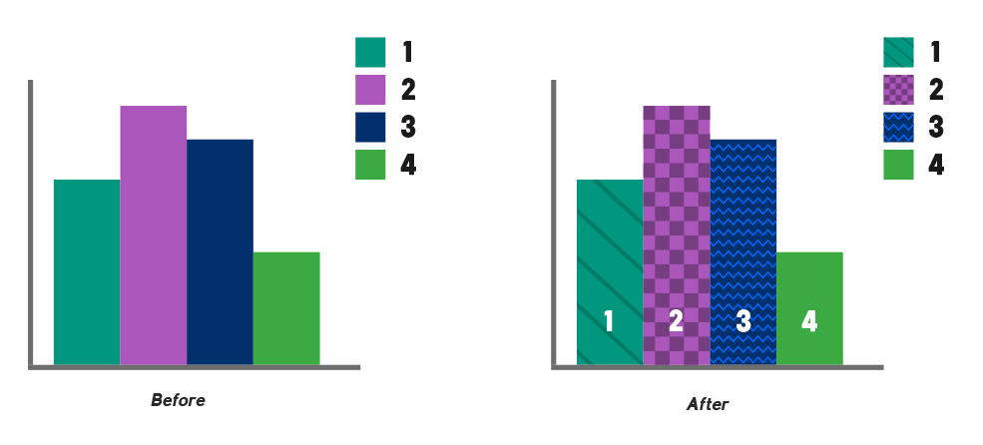
Ensure contrast between text and background
The Word accessibility checker can warn you if the contrast between the text and the background is not suitable.
Do not rely only on colour to communicate meaning.
Symbols and/or patterns used together with colour can make a graph or a diagram more accessible by helping users who cannot distinguish colour.

Slide 12
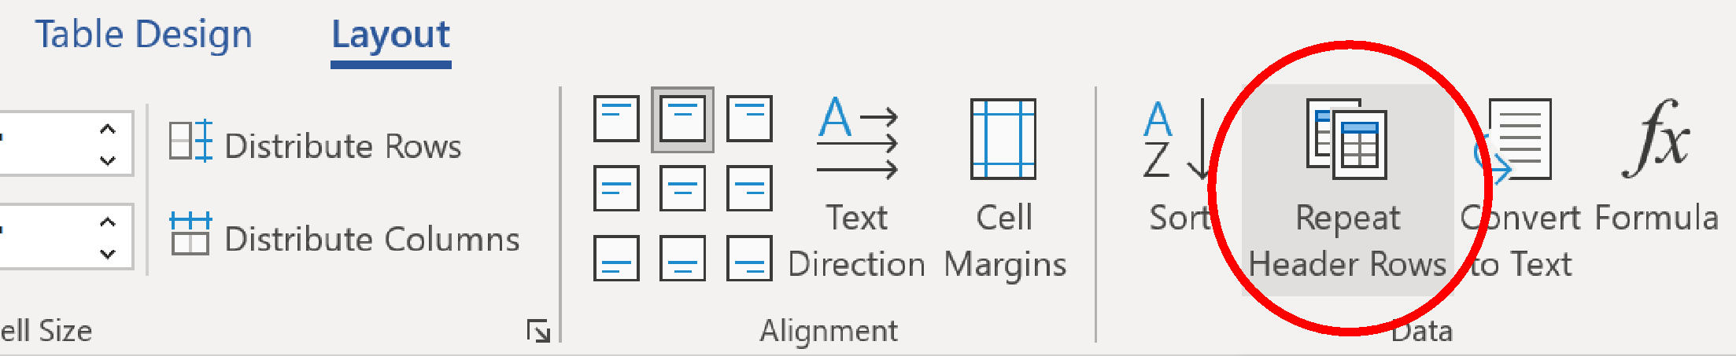
Making tables accessible
Use “header rows” in a table to improve navigation with a screen reader.
Select the row on the table you want to be a “header row.”
Go to the “Layout” tab in the toolbar (after the “table design” tab).
Select option “repeat header rows.” This allows your header row to be recognized as such by a screen reader and will repeat the header at the top of the page whenever the table is split between pages.
Avoid merging cells as this will create issues for a screen reader.
Add “Alt text” to the table by:
Right-click a table and Select “Table properties”;
Select the tab “Alt text”;
Enter a title and description in the box and hit save.

Slide 13
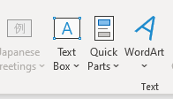
Avoid textboxes
A textbox can cause issues for a screen reader, particularly when wrapping is not set to “in line with the text”.
Instead of a textbox, consider a single cell table with formatting, or formatting applied directly to a normal text (background color, margins, etc.).
Notes:
PowerPoint has a checker to help you with this. It is a quick and simple way of making sure that there are no major accessibility challenges in your deck. Using it is simple and can be found on the review tab

Slide 14
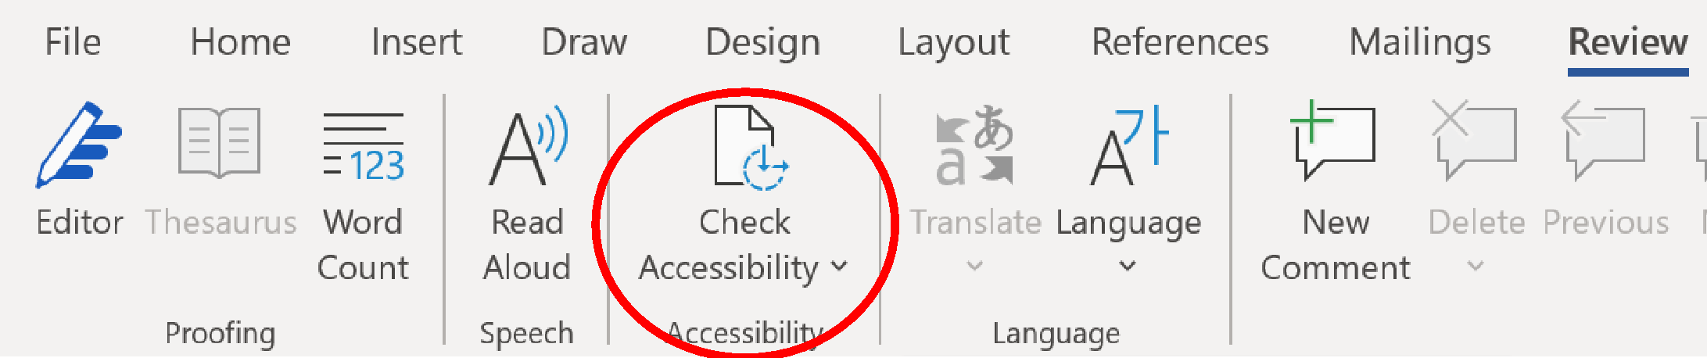
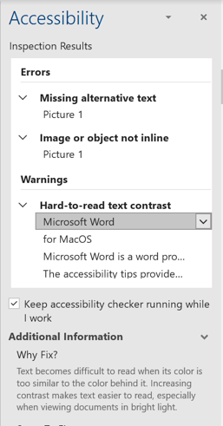
Use in-built accessibility checker
Go to the “Review” tab and click on “Check Accessibility”
The accessibility checker can help learn about accessibility issues and how to fix them.
An automated accessibility checker like the one included in Word is a very useful tool for validating a document.

Slide 15

Further sources of information
Read more about ways to make your Word documents accessible:
WebAim’s MS Word Techniques
Microsoft Guide to Accessible Word Documents
AbilityNet Factsheet for Accessible Word Documents

