Slide 1

Optimising Accessibility
Making PowerPoint Accessible to all

Slide 2




Accessibility in PowerPoint
The diversity of media in PowerPoint means we have to think about:
Layout
Text
Colour
Images
Video
Audio
Notes:
Intro the slide with:
Powerpoint is used for lots of purposes including training and reinforcing ideas. PowerPoints multimedia is its strength it offers lots of ways to communicate.

Slide 3
Top accessibility tips for PowerPoint
Notes:
Making PowerPoint accessible isn’t hard and there are lots of tools in the software to make it easier. Here are some of the major ones…

Slide 4
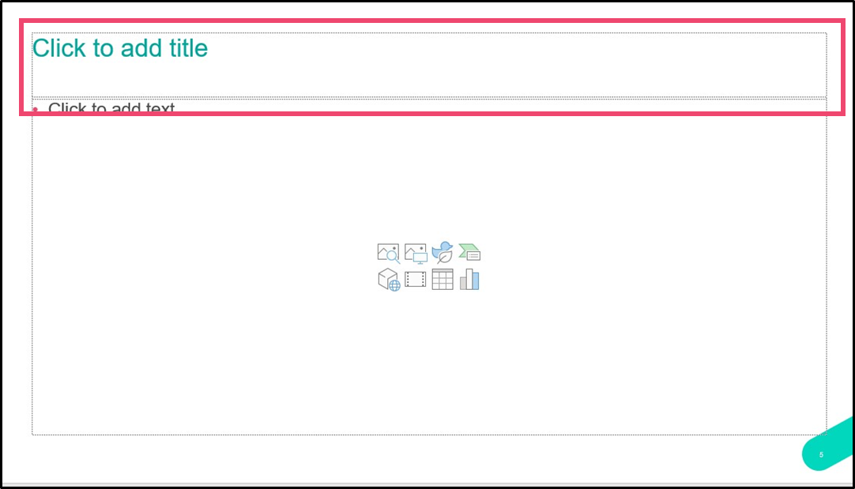
Tip 1 – Naming slides
Giving each slide a unique title helps people who are blind navigate the content and is helpful to everyone who wants to find a specific section to review later
Even slides that are just an image can have a hidden title beneath the image to help

Slide 5
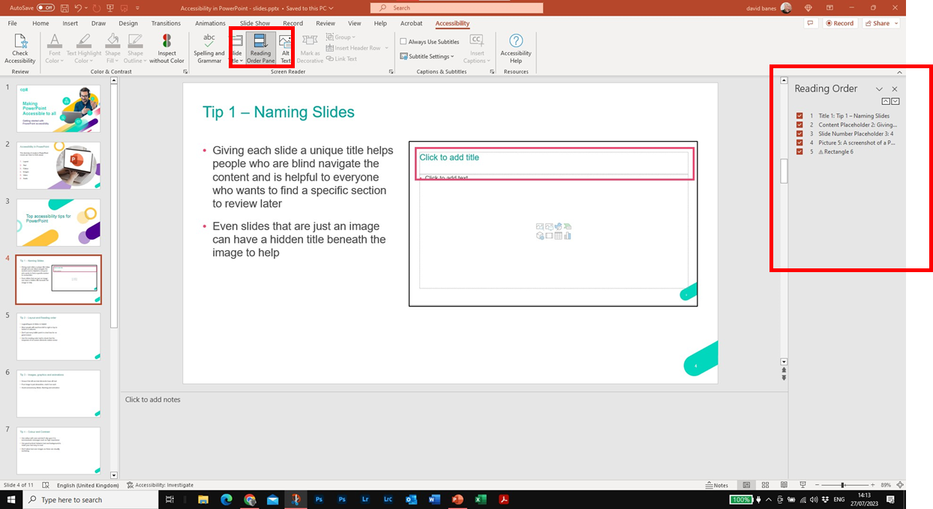
Tip 2 - Layout and Reading order
Logical layout of slides is helpful
Most people will read from left to right or top to bottom in columns
Don’t put every bullet point in a text box for no good reason
Use the reading order tool to check that the sequence of on-screen elements makes sense

Slide 6
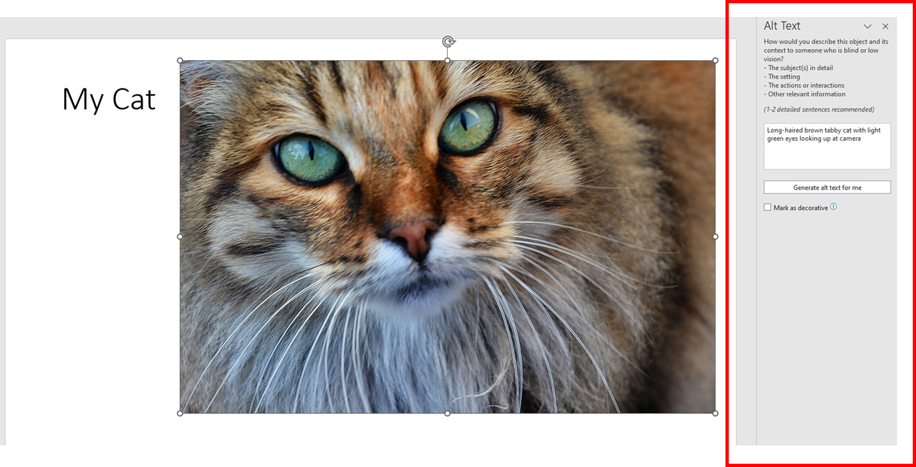
Tip 3 – Images, graphics and animations
Ensure that all non-text elements have alt text
If an image is just decorative, mark it as such
Avoid flicker, flashing and animation is possible.
You can check Alt Text and add it from the accessibility checker tab
Make sure the Alt Text describes the purpose of the image

Slide 7

Tip 4 – Colour and Contrast
Use colour with care and don’t rely upon it to communicate messages such as high importance
Use good contrast between text and background to make your text easy to read
Don’t place text over images as these are visually confusing

Slide 8
Tip 5 – Fonts and Text
Accessibility 8
Accessibility 12
Accessibility 14
Accessibility 18
Accessibility 24
Accessibility 36
Accessibility 48
Use a good sans serif font for text – this is easier to read
Limit the amount of text on the screen
Use minimum 18pt text

Slide 9
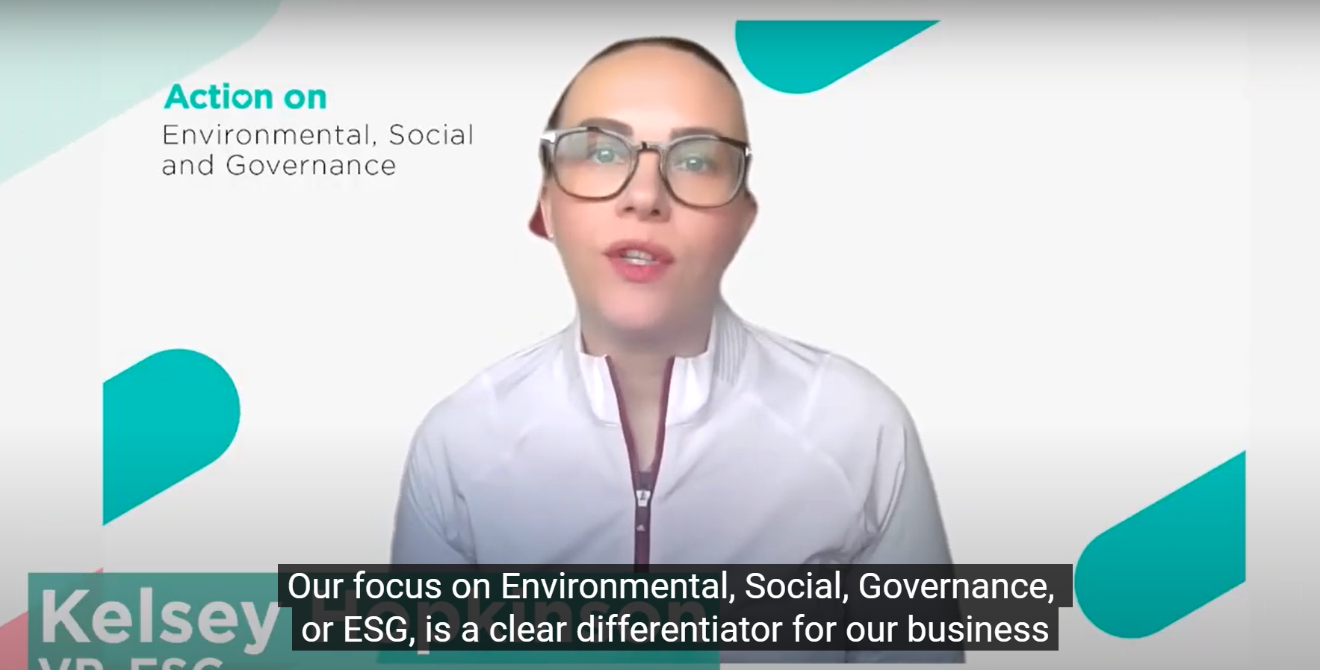
Tip 6 – Video and audio
Video should have captions which should be verbatim
Provide a transcript of audio files that contain all information such as who the speakers are, if that is relevant to understanding the content.

Slide 10
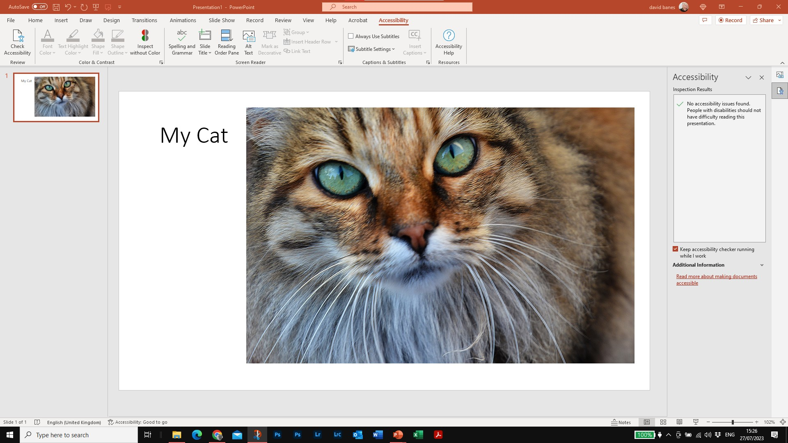
Accessibility Checker
The accessibility checker is your best tool for checking that any PowerPoint you make is accessible to everyone
The more you use it, the easier it becomes
Notes:
PowerPoint has a checker to help you with this. It is a quick and simple way of making sure that there are no major accessibility challenges in your deck. Using it is simple and can be found on the review tab

Slide 11

Further sources of information
If you want further advice, you can find resources at:
WebAim’s Guide to Accessible Powerpoint
Microsoft Guidance
BBC Video Captioning Guide

