Slide 1
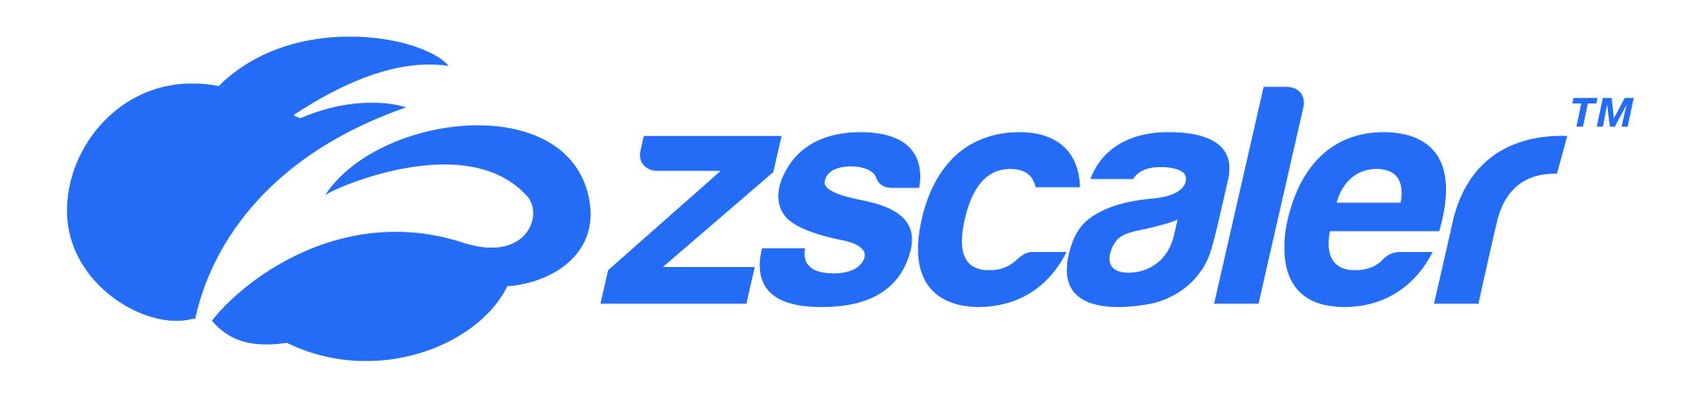
Customer Success Story – European private bank
The solution
Colt Secure Network Gateway, a cloud-native security service edge (SSE) platform, delivered through an opex model in partnership with market leader Zscaler. Unlike competitor solutions, the best-in-class feature-rich Zscaler solution passed critical use cases.
The result
Secure Network Gateway fits the bank’s cloud and managed services strategies and its drive towards Zero Trust hybrid working. The bank is experiencing improvements in its security posture, and knows the solution can easily evolve to meet future needs.
Client
Private bank
Partner
Zscaler
Sector
Financial services
Products and services
Secure Network Gateway
Locations
Multiple European locations
Number of employees
~2,000
Business drivers – why Secure Network Gateway?
The bank had experienced a short-term compelling event as its legacy security equipment was reaching end of life. It needed a security solution that could support its strategic transformation from on-premises infrastructure to hybrid cloud services.
Why Colt?
The bank’s existing partnership with Colt for WAN connectivity engendered trust in Colt’s recommendation for the cloud-based security platform. The bank also enjoys the convenience of having Colt as its single provider of both networking and security solutions.

Slide 2
Customer Success Story – European private bank
Business drivers – why Secure Network Gateway?
A private bank with multiple locations across Europe was transforming from on-premises infrastructure and applications to hybrid cloud services. In line with that transition, and to support its Zero Trust hybrid working ambitions, the bank wanted to replace its on-premises security stack with a managed cloud-based alternative.
Having discounted several cloud security solutions owing to missing features, the bank discussed his needs with Colt, the bank’s trusted provider of WAN connectivity (IP VPN and IP Access) across Europe.
Colt proposed Secure Network Gateway, its always-on, cloud-based security solution at the network edge, delivered in partnership with market leader Zscaler.
What did the bank need from its security solution?
The bank wanted to protect against cyberattacks and threats by enabling its employees to connect to the internet and cloud-based applications with the same high level of protection, whether in the office or working remotely.
The solution also had to support the bank’s compliance with its own stringent internal policies (set by the CISO), and with the requirements of the financial services authorities in its operating countries.
The Colt and Zscaler difference
Zscaler operates the world’s largest cloud security platform. Colt peers directly with Zscaler in 21 locations worldwide to minimise latency and deliver consistent application performance and a great user experience.
As a trusted partner of both the bank and Zscaler, Colt ensured that all parties had clear, common insight into the bank’s vision and objectives.
The Colt team provided consultancy, ensured that the Zscaler solution developed was explicitly fulfilling the goals, and facilitated commercial negotiations during the pre-sales and sales processes.
The bank benefits from a fully managed cloud security solution, delivered through an opex model, that:
Improves its security posture and supports its compliance,
Offers more than its previous
on-premises solution,
Allows the bank to pursue its Zero Trust networking strategy,
Is modular and can evolve and expand to support the bank’s future needs with native Zscaler capabilities.
On top of that, the bank enjoys the simplicity and convenience of having Colt as its one-stop shop for both WAN connectivity and cloud-based security.
Client
Private bank
Partner
Zscaler
Sector
Financial services
Products and services
Secure Network Gateway
Locations
Multiple across Europe
Number of employees
~2,000

Slide 3
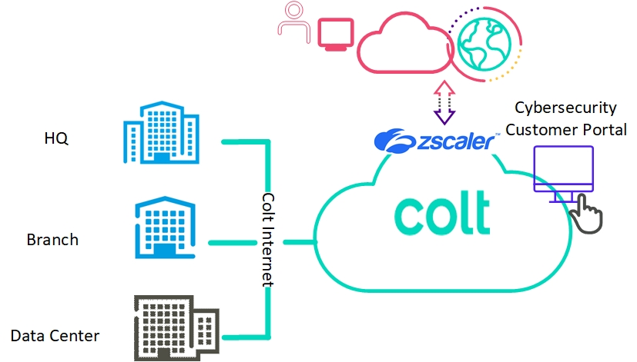
Customer Success Story – European private bank
Client
Private bank
Partner
Zscaler
Sector
Financial services
Products and services
Secure Network Gateway
Locations
Multiple across Europe
Number of employees
~2,000

